Slide 1
War Sentiment Analysis
Written By | Mohammad Danish

Slide 2
Objective:
“You have to analyse the data which is given in multiple language. You can filter the english language and then analyse tweets by various users to analyse the sentiments based on keywords and conclude the findings.

Slide 3
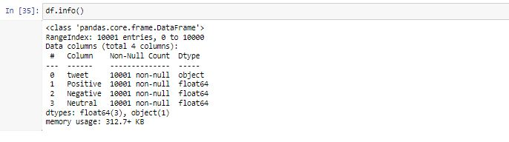
Data Description
Given is the variable name, variable type, the measurement unit, and a brief description. The concrete compressive strength is the regression problem. The order of this listing corresponds to the order of numerals along the rows of the database.

Slide 4
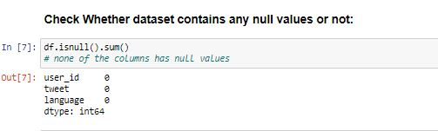
1. Data Insertion
Data has call into the Jupyter notebook from Excel file and convert into Pandas DataFrame.
2. Data preprocessing
In given Data Set there has been no null value to fill.
Check how many tweets are posted in English language.

Slide 5
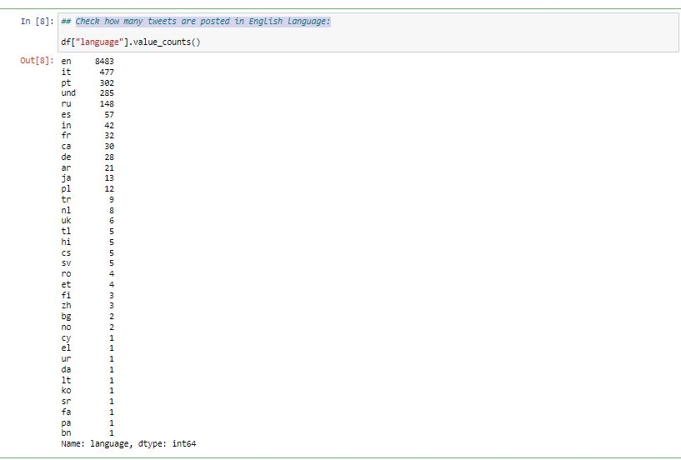
So it is Clear that most of the tweets are in English

Slide 6
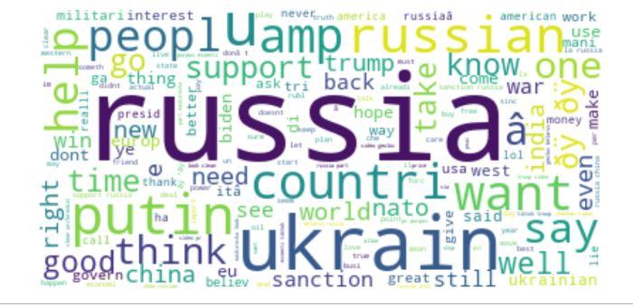
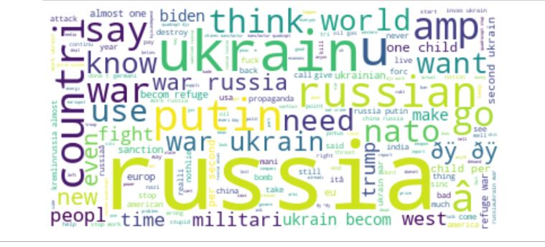
Word Cloud to check the Positive or Negative Sentiment
Positive Sentiment
2.Negative Sentiment

Slide 7
Conclusion
So this is how you can analyze the sentiments of people over the war. People having Mix reaction about the war but it seems from Tweets that people need peace and harmony for the betterment of humankind.
THE END

